Slide 1
Analyzing the Impact of Car Features on Price and Profitability BY Sakshi rahiwal
Car_features_excel_report.xlsx

Slide 2
Project Description
Overview of the Project and its Purpose:
The project focuses on leveraging data analytics to assist a car manufacturer in optimizing pricing and product development decisions. The primary goal is to maximize profitability while meeting consumer demand in the rapidly evolving automotive industry.
Business Problem or Question:
The key business question is: How can a car manufacturer optimize pricing and product development decisions to maximize profitability while meeting consumer demand? This involves understanding the factors driving consumer demand, analyzing the relationship between car features, market categories, and pricing, and identifying the most profitable and popular features.
Data Sources Used:
The dataset titled "Car Features and MSRP" was utilized for this project. It contains information on over 11,000 car models, encompassing details such as make, model, year, engine specifications, transmission type, market category, fuel efficiency, popularity, and manufacturer's suggested retail price (MSRP). The dataset was collected and made available on Kaggle by Cooper Union.

Slide 3
Data Cleaning and Preprocessing Steps:
Handling Missing Data: Checked for missing values in the dataset and applied appropriate methods such as imputation or removal based on the context.
2. Data Type Conversion: Ensured that variables were in the correct data types for analysis. For example, converting categorical variables to the appropriate data type.
3. Outlier Detection and Handling: Identified and addressed outliers in relevant variables to prevent them from skewing the analysis.
4. Standardization and Scaling: Standardized numerical features to ensure a consistent scale for more accurate analysis, especially in regression analysis.
5. Handling Categorical Variables: Applied one-hot encoding or other encoding methods to convert categorical variables into a format suitable for analysis.
Assumptions Made:
1. Data Accuracy: Assumed that the provided dataset is accurate and representative of the actual market conditions. Any inaccuracies or biases in the data could influence the results.
2. Market Dynamics: Assumed that the market dynamics reflected in the dataset are still relevant, considering the dataset's last update in 2017. Market trends may have evolved since then.
3. Consumer Preferences: Assumed that consumer preferences, as indicated by features like popularity, remain consistent over time.

Slide 4
Approach
Analytical Methods Used:
Descriptive statistics for summarizing key features.
Visualization techniques, including pivot tables, combo charts, scatter plots, and regression analysis.
Regression analysis to identify key variables affecting car prices.
Reasoning Behind Analytical Methods:
Descriptive statistics offer a quick overview of the dataset.
Visualization aids in understanding relationships and patterns.
Regression analysis provides a quantitative understanding of the impact of variables on car prices.
Challenges or Limitations:
Limited to historical data up to 2017.
External factors influencing the automotive industry are not considered.
The dataset might not capture the latest market trends.

Slide 5

Tech-Stack Used
Microsoft Excel: 2021
Excel was the primary tool for data analysis in this project.
Excel's functionalities, including pivot tables, charts, regression analysis, and data manipulation, were leveraged.
Excel offers a user-friendly interface, making it accessible to a wide range of users.

Slide 6
Insight
How does the popularity of a car model vary across different market categories?
Task 1.A: Create a Pivot Table
The relationship between market categories and popularity, a pivot table can be created. Steps are –
Open the Excel file containing the dataset.
Select the entire dataset, including headers.
Go to the "Insert" tab and choose "PivotTable."
In the PivotTable Field List:
Drag the "Market Category" field to the Rows area.
Drag the "Popularity" field to the Values area. Ensure it's set to display as "Count of Popularity" or "Sum of Popularity," depending on your preference.
The resulting pivot table should show the count or sum of popularity for each market category.

Slide 7
Task 1.B: Create a Combo Chart
To visualize the relationship between market category and popularity, a combo chart can be created. Follow these steps:
In the same Excel file, go to the "Insert" tab and choose "Combo Chart."
In the Chart Design menu, select the "Combo" chart type.
Assign "Market Category" to the primary horizontal (category) axis.
Assign "Count of Popularity" or "Sum of Popularity" to the primary vertical (value) axis.
5. Column and line chart for the Popularity series.
This combo chart will display the relationship between market categories and their corresponding popularity scores.

Slide 8
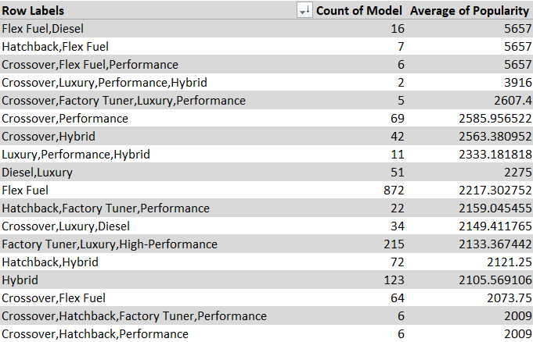
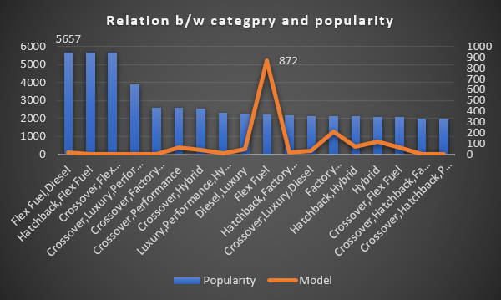
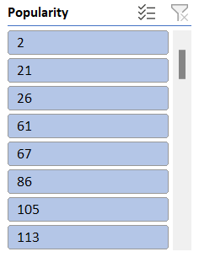
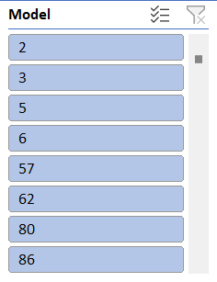
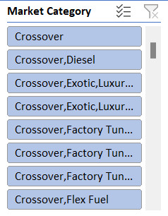
Combo chart

Slide 9
Interpretation:
The pivot table provides a quantitative overview of how many car models fall into each market category and their total popularity scores.
The combo chart visually represents the distribution of popularity across different market categories, making it easier to identify trends or variations.
Conclusion:
By analyzing the pivot table and combo chart, we can identify Hatchback, Flex Fuel market categories have a higher concentration of popular car models. This insight can guide marketing strategies, helping the manufacturer focus on or adjust their product offerings based on market preferences.

Slide 10
2. What is the Relationship Between a Car's Engine Power and its Price?
Task 2: Create a Scatter Chart with Trendline
To understand the relationship between a car's engine power and its price, a scatter chart with a trendline can be created using Microsoft Excel. Follow these steps:
Open the Excel file containing the dataset.
Select the columns containing "Engine Power" and "MSRP (Price)."
Go to the "Insert" tab and choose "Scatter Chart.“
The scatter chart will be created. Right-click on any data point, and choose "Add Trendline.“
In the "Format Trendline" pane, choose the type of trendline (linear) depending on the nature of the relationship.
Display the equation on the chart by checking the "Display Equation on chart" option.

Slide 11
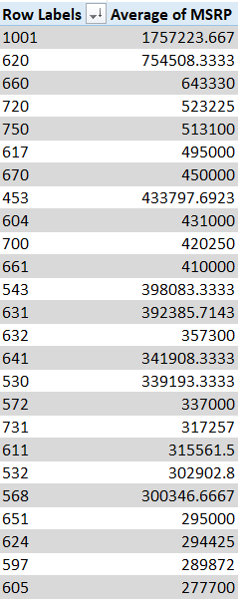
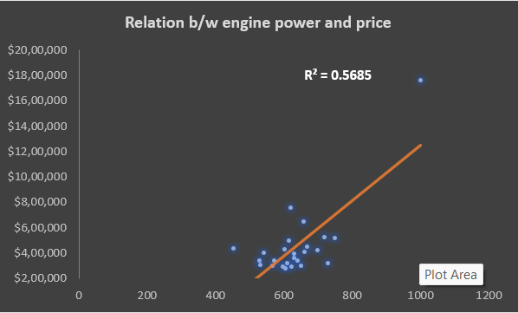
Scatter chart
Engine HP is directly proportional to MSRP. It means as much as Engine HP increases Price of the car also increases.

Slide 12
Interpretation:
Insight:
By analyzing the scatter chart and trendline equation, we can gain insight that when Engine HP is increases then Price of car also increases. This understanding is valuable for pricing strategies and product positioning.
The scatter chart will display individual data points representing the relationship between engine power and price for each car model.
The trendline, based on the chosen linear type, will visually represent the overall trend or correlation between engine power and price.

Slide 13
3. Which car features are most important in determining a car's price?
Task 3: Regression Analysis and Bar Chart
To identify the variables that have the strongest relationship with a car's price and visualize their relative importance, regression analysis and a bar chart can be used. Follow these steps using Microsoft Excel:
Open the Excel file containing the dataset.
Select the variables that might influence the car's price. Common variables may include "Engine Cylinder," "Number of Door," "Highway MPG”, ”City MPG”, ”MSRP” depending on the dataset.
Go to the "Data" tab and choose "Data Analysis." If you don't see "Data Analysis," you may need to enable it in Excel's options.
Select "Regression" and input the relevant data range.
Specify the output range for the regression results.
Click "OK" to run the regression analysis.
The regression output will include coefficients for each variable. Create a new table with variable names and their corresponding coefficients.

Slide 14
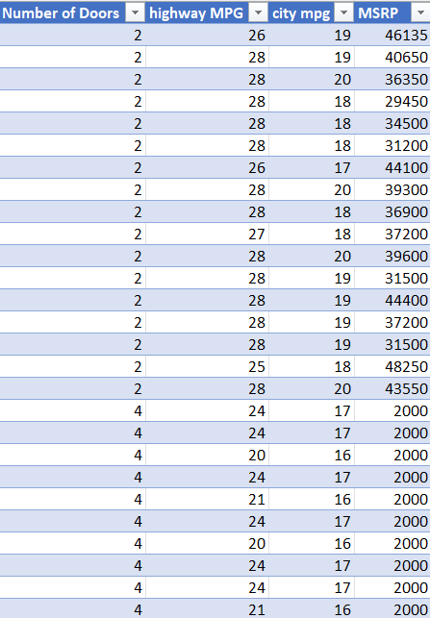
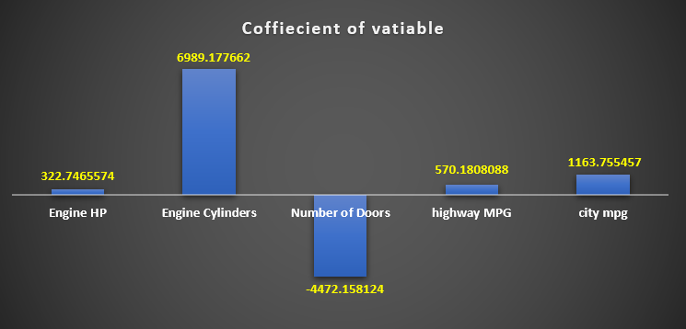
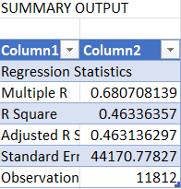
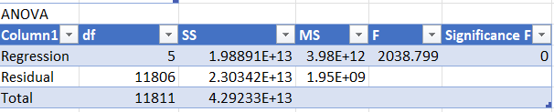
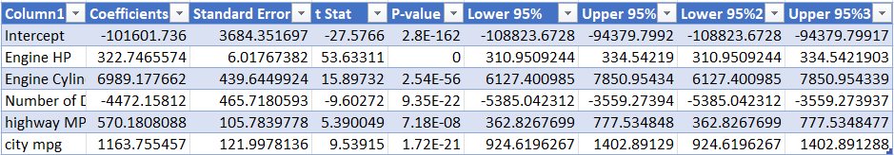
9. Create a bar chart using the coefficient values. You may want to sort the coefficients in descending order for better visualization.

Slide 15
Interpretation:
The regression analysis identifies the coefficients for each variable, representing their impact on the car's price.
The bar chart visually displays the relative importance of each variable based on their coefficients.
Insight:
By examining the bar chart, we can identify that Engine Cylinder have the strongest impact on pricing.
Features with higher positive coefficients contribute more to increasing the car's price, while those with higher negative coefficients contribute to price reduction.

Slide 16
4. How Does the Average Price of a Car Vary Across Different Manufacturers?
Task 4.A: Create a Pivot Table
To analyze the average price of cars across different manufacturers, a pivot table can be created. Follow these steps using Microsoft Excel:
Open the Excel file containing the dataset.
Select the columns containing "Manufacturer" and "MSRP" (Manufacturer's Suggested Retail Price).
Go to the "Insert" tab and choose "PivotTable.“
The resulting pivot table should show the average MSRP for each manufacturer.
Task 4.B: Create a Bar Chart
To visualize the relationship between manufacturer and average price, a bar chart or horizontal stacked bar chart can be created:
1.Highlight the pivot table data.
2. Go to the "Insert" tab and choose "Bar Chart" or "Stacked Bar Chart."

Slide 17
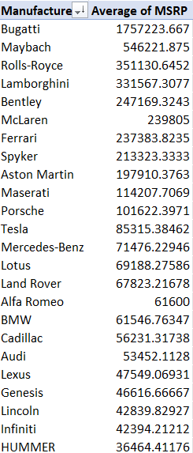
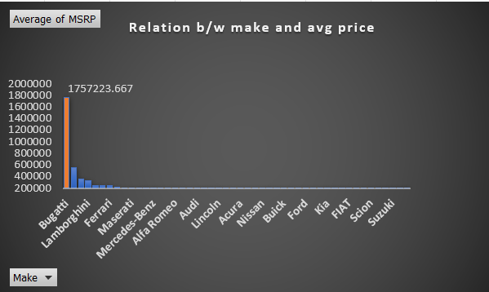
3. Adjust the chart settings to display the data appropriately.
For a bar chart, assign the manufacturer to the horizontal axis and average MSRP to the vertical axis.
For a stacked bar chart, add the manufacturer as the series and average MSRP as the values.

Slide 18
Interpretation:
The pivot table provides a quantitative overview of the average price of cars for each manufacturer.
The bar chart visually represents the average prices, allowing for easy comparison between manufacturers.
Insight:
Analyzing the bar chart we identify that manufacturers with higher or lower average prices. This insight can be valuable for competitive positioning and pricing strategies

Slide 19
5. What is the relationship between fuel efficiency and the number of cylinders in a car's engine?
Task 5.A: Create a Scatter Plot with Trendline
To understand the relationship between fuel efficiency and the number of cylinders in a car's engine, a scatter plot with a trendline can be created using Microsoft Excel. Follow these steps:
Open the Excel file containing the dataset.
Select the columns containing "Number of Cylinders" and "Highway MPG."
Go to the "Insert" tab and choose "Scatter Chart."
The scatter chart will be created. Right-click on any data point and choose "Add Trendline.“
In the "Format Trendline" pane, choose the type of trendline (linear, exponential, etc.) depending on the nature of the relationship.
Display the equation on the chart by checking the "Display Equation on chart" option.

Slide 20
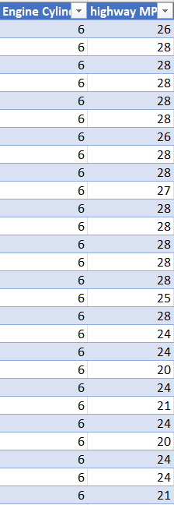
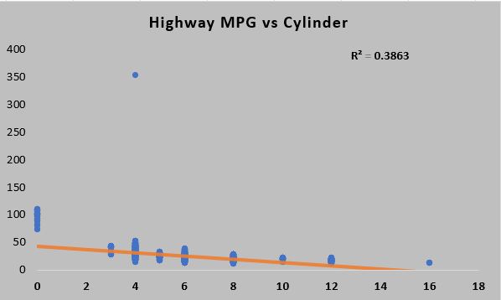
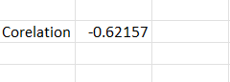
Task 5.B: Calculate the Correlation Coefficient
To quantify the strength and direction of the relationship between the number of cylinders and highway MPG, calculate the correlation coefficient using Excel. Follow these steps:
1.In an empty cell, use the formula =CORREL(range1, range2) where "range1" is the column of the number of cylinders, and "range2" is the column of highway MPG.
2. The result will be the correlation coefficient, indicating the strength and direction of the relationship.

Slide 21
Interpretation:
The scatter plot with the trendline visually represents the relationship between the number of cylinders and highway MPG.
The equation on the chart shows the estimated slope of the relationship.
Insight:
By analyzing the scatter plot and trendline, you can observe whether there's a positive or negative correlation between the number of cylinders and highway MPG. This insight is crucial for understanding the trade-off between engine power and fuel efficiency.
The correlation coefficient quantifies the strength and direction of the relationship. A negative correlation would imply that more cylinders are associated with lower fuel efficiency, and vice versa.

Slide 22
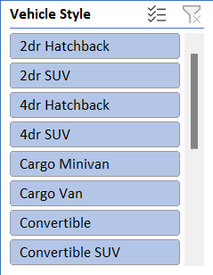
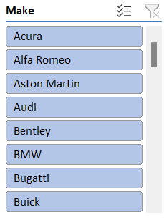
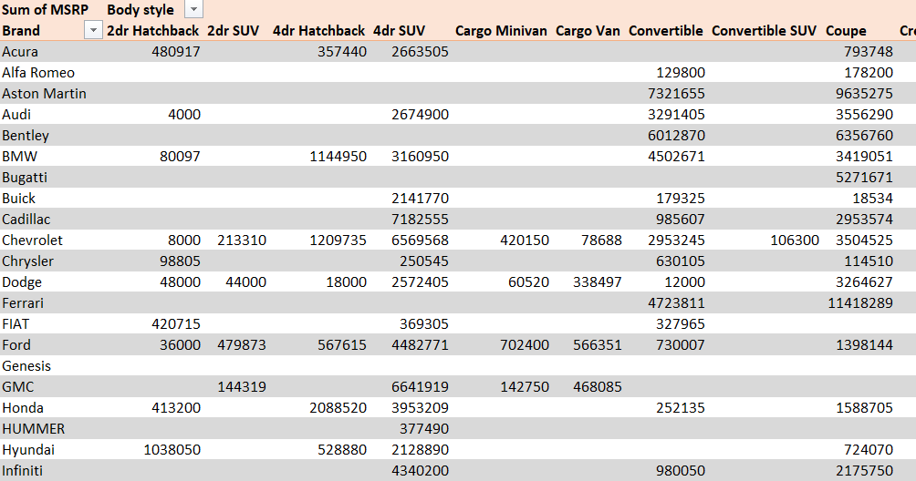
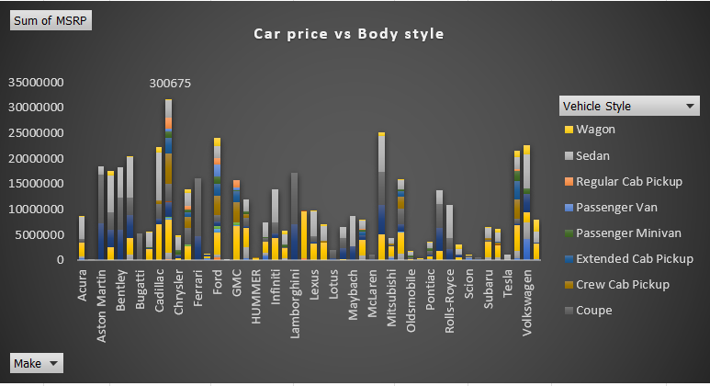
Dashboard
1. Distribution of Car Prices by Brand and Body Style:
Stacked column chart.
Filters: Brand and Body Style.
Use SUMIF or Pivot Tables to calculate the total MSRP for each brand and body style.

Slide 23
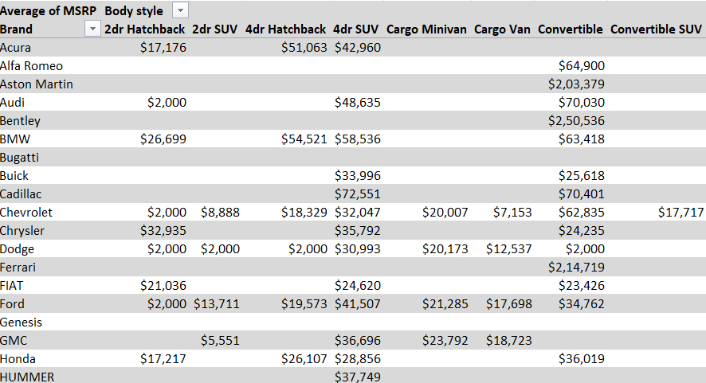
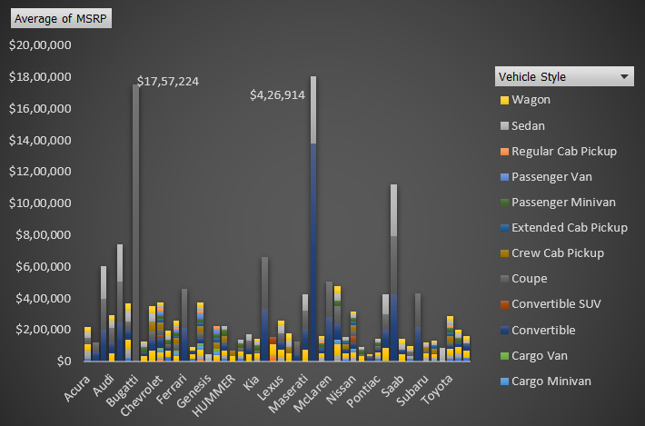
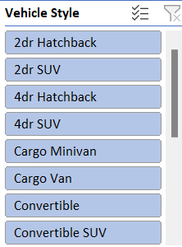
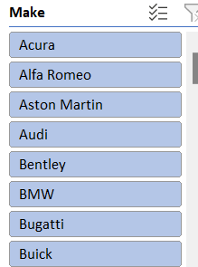
2.Average MSRPs by Car Brand and Body Style:

Slide 24
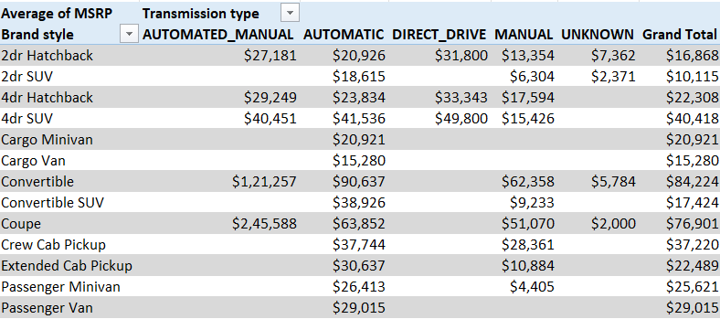
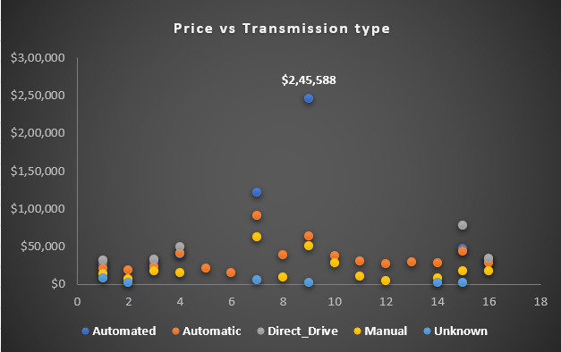
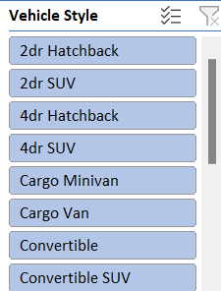
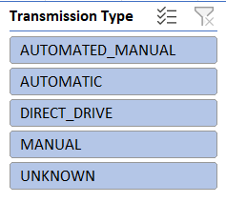
3.Effect of Transmission Type on MSRP by Body Style:
Scatter plot chart.
Filters: Transmission Type and Body Style.
Use AVERAGEIFS or Pivot Tables to calculate the average MSRP for each combination of transmission type and body style.

Slide 25
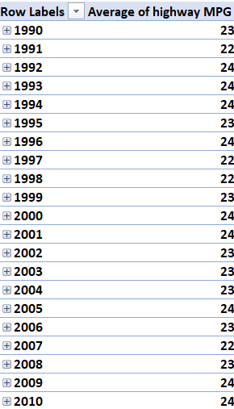
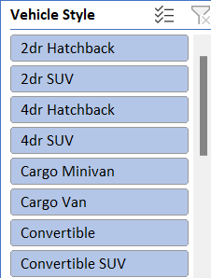
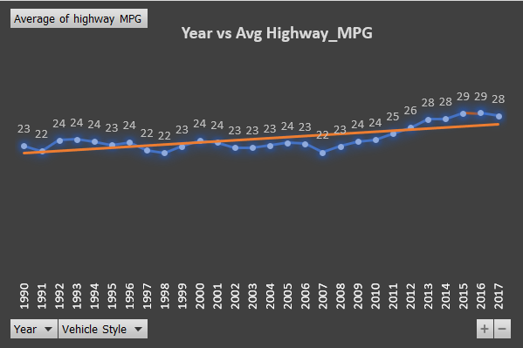
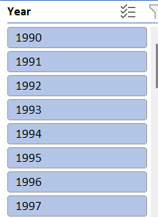
4.Variation of Fuel Efficiency Across Body Styles and Model Years:
Line chart.
Filters: Body Style and Model Year.
Use AVERAGEIFS or Pivot Tables to calculate the average MPG for each combination of body style and model year.

Slide 26
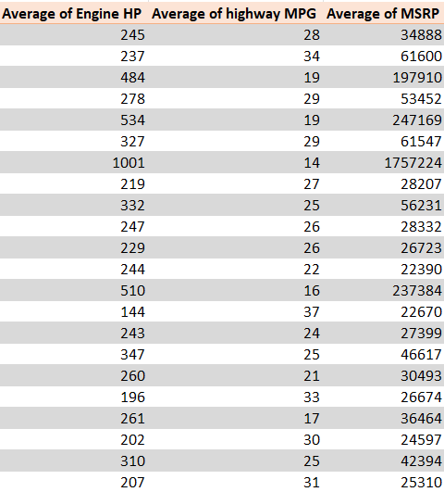
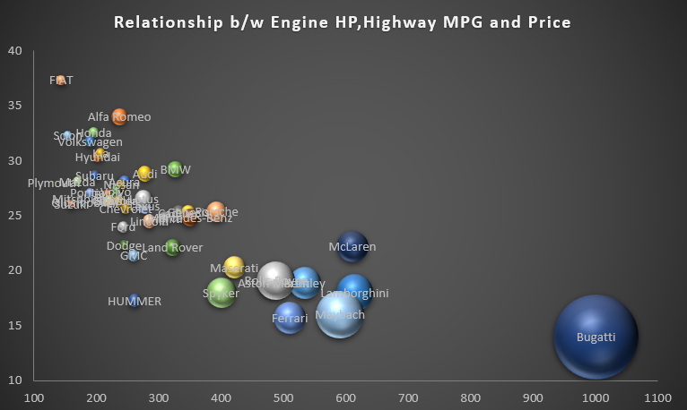
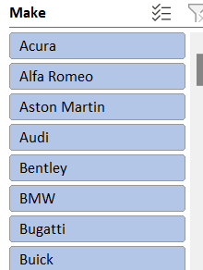
5.Relationship Between Horsepower, MPG, and Price by Brand:
Bubble chart.
Filters: Brand.
Use AVERAGEIFS or Pivot Tables to calculate the average horsepower, MPG, and MSRP for each car brand.

Slide 27
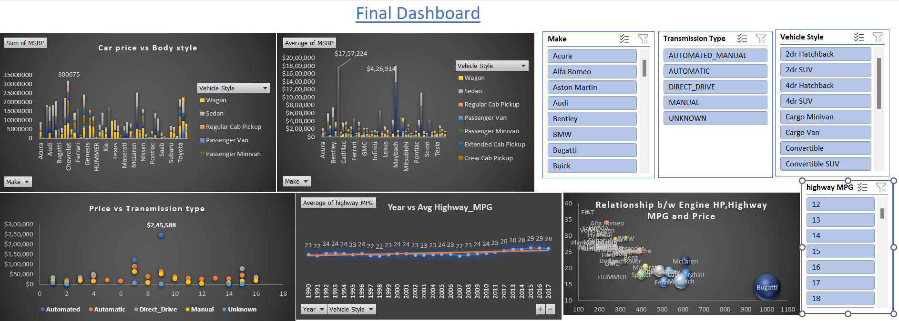
FINAL DASHBOARD
Final Dashboard For Analysis Impact of Car Features on Price

Slide 28
Result
The interactive dashboard serves as a powerful tool for decision-makers, offering a visually intuitive representation of critical insights. It allows for a deeper understanding of the relationships within the dataset, empowering strategic decisions related to pricing, product development, and market positioning.
The following key takeaways emerge:
Price Distribution Insights:
Clear patterns in how car prices are distributed across different brands and body styles.
Identifiable trends in pricing that can influence marketing and positioning strategies.
Average MSRPs Variation:
Discernible differences in average MSRPs among various car brands and body styles.
Valuable information for manufacturers to align their pricing strategies with market expectations.
Transmission Type Influence:
Understanding how transmission type impacts MSRP provides actionable insights for product development and pricing decisions.

Slide 29
Fuel Efficiency Trends:
Visualizing fuel efficiency trends across body styles and model years aids in anticipating consumer preferences and regulatory compliance.
Limitations and Uncertainties
1.Dataset Currency:
The dataset's last update in 2017 raises concerns about its relevance to current market conditions.
Trends and prices may have evolved since then, potentially impacting the accuracy of insights.
2. External Factors:
External factors, such as economic changes or global events, were not considered in the analysis.
These factors could significantly influence the automotive industry and may not be captured in the dataset.
Future Directions
1. Data Refresh:
Regular updates to the dataset are recommended to ensure insights remain relevant.
A more current dataset would enhance the accuracy of analyses and better reflect market trends.

Slide 30
2. Incorporating External Factors:
Future analyses should consider external factors influencing the automotive industry.
Incorporating economic indicators and global events could provide a more comprehensive understanding of market dynamics.
The interactive dashboard, coupled with a recognition of limitations and future considerations, positions this analysis as a valuable tool for strategic decision-making in the dynamic automotive landscape.

Slide 31
Thank you
sakshirahiwal155@gmail.com

